Slide 1
DR framework using ADF, Azure APIs

Slide 2
Agenda
HL DR Architecture
HL Implementation Design
Azure SDK libraries
API usage- Code Walkthru on VS
Demo
Azure Portal
References
Q&A

Slide 3
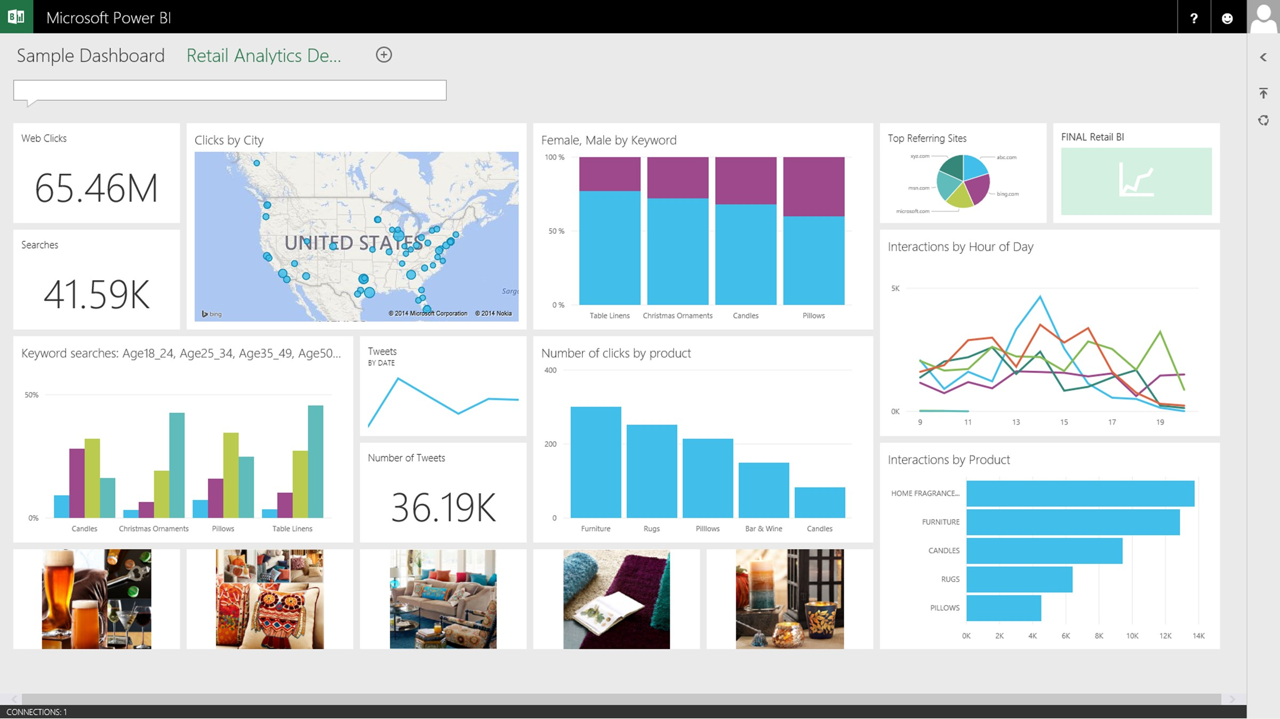
Mid-level hybrid DR architecture
Azure Blob Storage
Azure
IaaS
PaaS
LOAD PROCESS workflow
DATA SOURCES
Unstructured
Semi-Structured
Structured
Relational (RDBMS)
Azure SQL DW
INIT workflow
ARCHIVE workflow
On-Premises
LOAD PROCESS workflow
PaaS
APS
Azure SQL DB (Control DB)

Slide 4
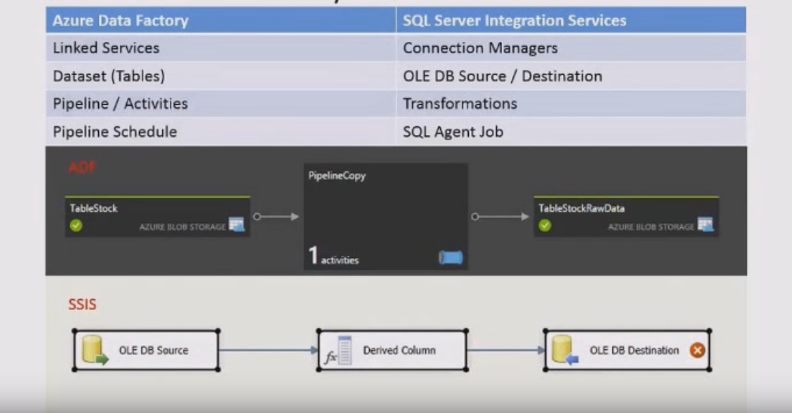
Azure Data Factory vs SSIS

Slide 5

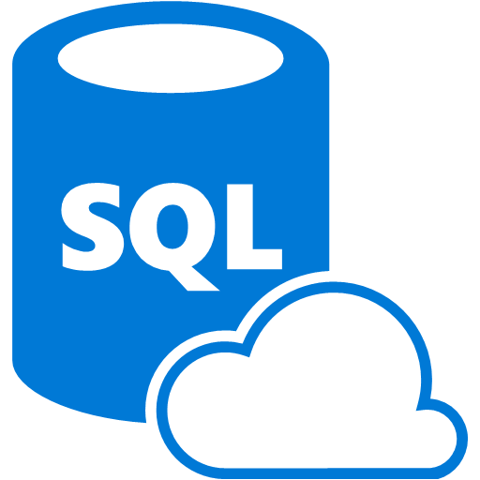


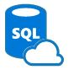
Init workflow
WorkflowInit.cs
SQL Query
Control DB
DR Data Factory
Source
Data Extract
Stored Procedure
Azure Storage Query
ToBeProcessed
File 1
INIT Pipeline 1
File 2
INIT Pipeline 2
File N
INIT Pipeline N
Data Factory

Slide 6
Load Process workflow
Loading workflow run on both Primary as well as Secondary APS system
LoadProcess.cs
SQL Query
Control DB
DR Data Factory
Stored Procedure
Transform,
Loading
Stored Procedure
File 1
LOAD Pipeline 1
File 2
LOAD Pipeline 2
File N
LOAD Pipeline N
Data Factory

Slide 7
Archive workflow
Archive.cs
SQL Query
Control DB
DR Data Factory
Stored Procedure
Move to Archive
File 1
ARCHIVE Pipeline 1
File 2
ARCHIVE Pipeline 2
File N
ARCHIVE Pipeline N
Data Factory

Slide 8
Azure SDK libraries
Azure SDK 2.8 for Visual Studio 2013 and Visual Studio 2015
Azure Data Factory Tools: are now also available in VS 2015, which simplifies the ADF authoring experience and remove on-boarding and deployment challenges. (https://azure.microsoft.com/en-us/blog/azure-data-factory-visual-studio-extension-for-authoring-pipelines/)
https://azure.microsoft.com/en-us/documentation/articles/data-factory-sdks/

Slide 9
Code Walkthru

Slide 10
Demo

Slide 11
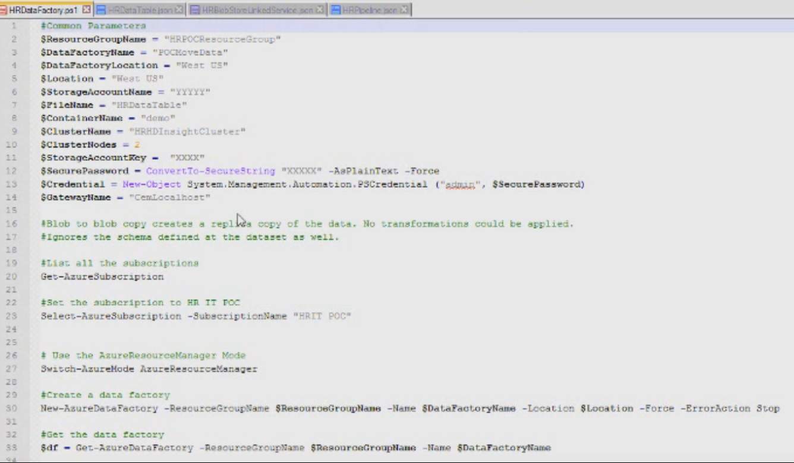
PowerShell ADF creation- I

Slide 12
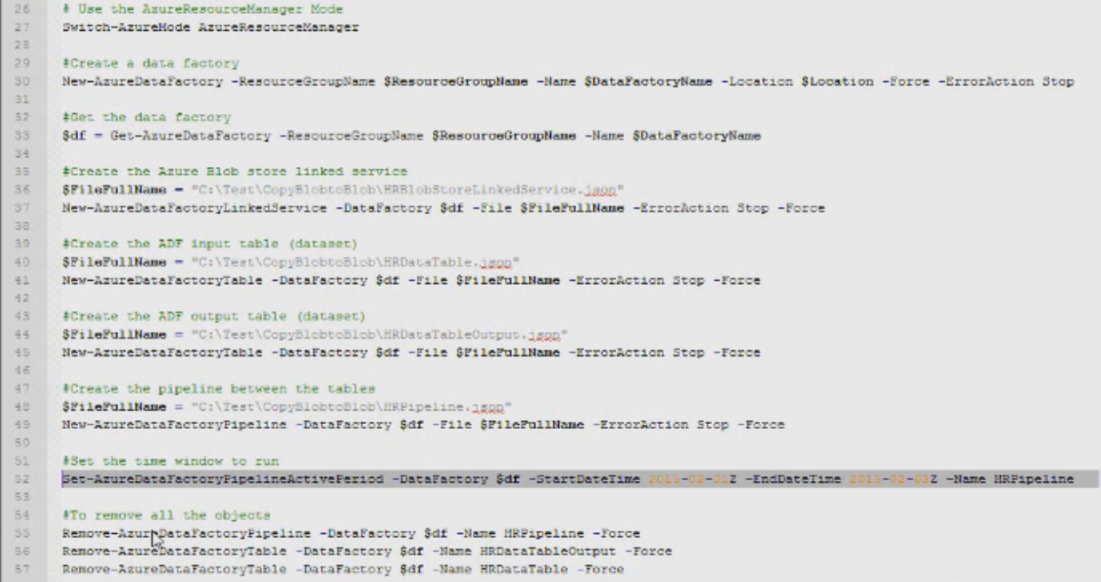
PowerShell ADF creation- II

Slide 13
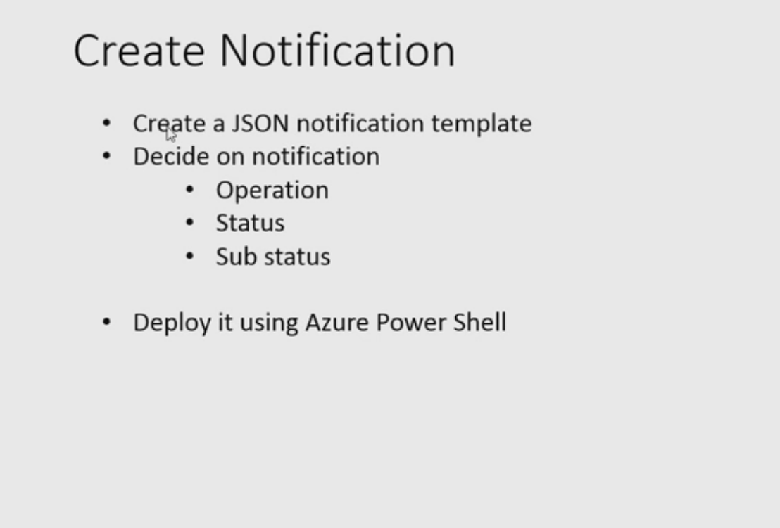
ADF Notifications-I

Slide 14
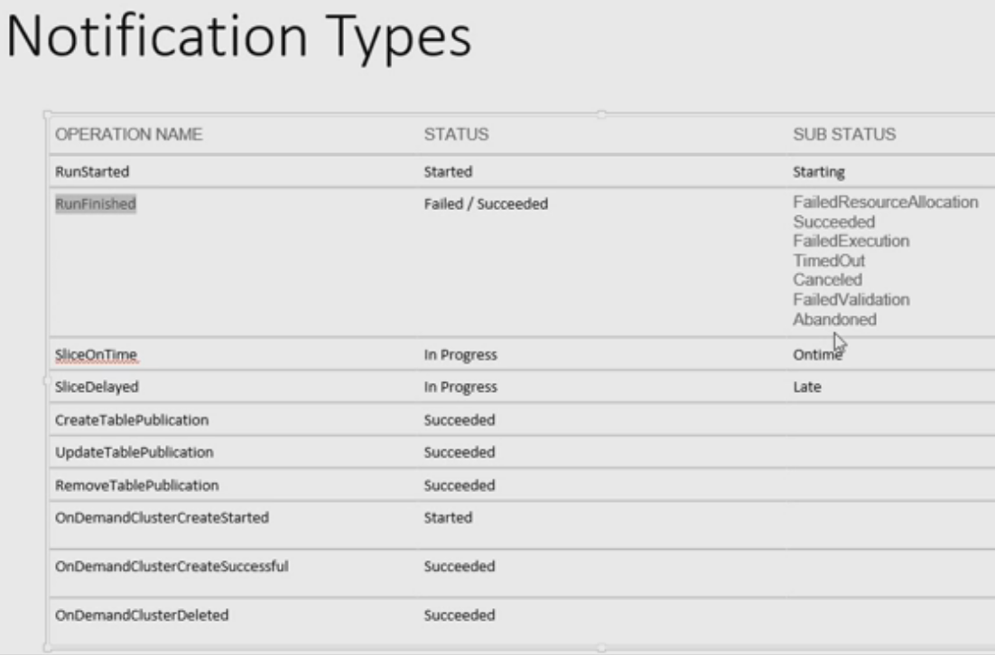
ADF Notifications-II

